Slide 1
CLINT: Cognitive Load in Interpreting and Translation
Michael Boos

Slide 2
Fundamental idea of the project
Background:
English as a first global lingua franca
Costs and consequences for non-native speakers
Interpreters/translators vs. untrained multilinguals
Stress and workload related impacts of English as a lingua franca (ELF) on professionals
Notes:
ELF pushing other languages into subsidiary roles in international business, finance, education and science
•Ethnologue estimates: five non-native speakers of English for every native speaker (Simons and Fennig 2018)
•Reality of millions of people communicating in a language that is not their first -> enormous repercussions for multilingualism and multilingual societies
•Little research into the cost-related impact on and consequences for non-native speakers who have to work in English
•Academic study of ELF tends to focus on communicative success between non-native speakers and the linguistic and sociolinguistic aspects of the phenomenon (Jenkins 2007, Seidlhofer 2011, Mauranen 2012)
Explain the difference between Interpretation and Translation

Slide 3


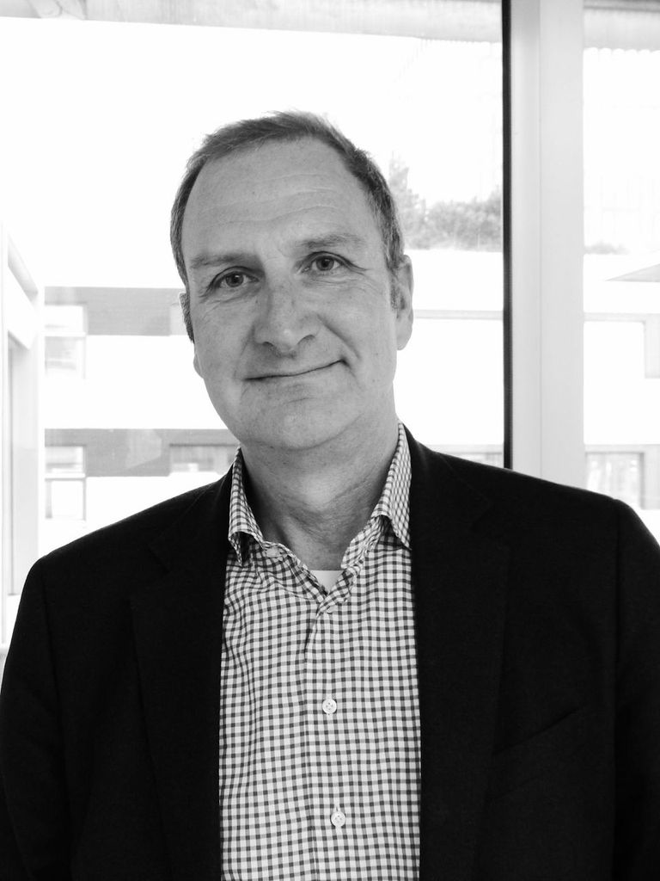

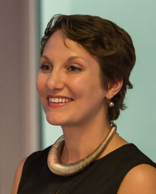



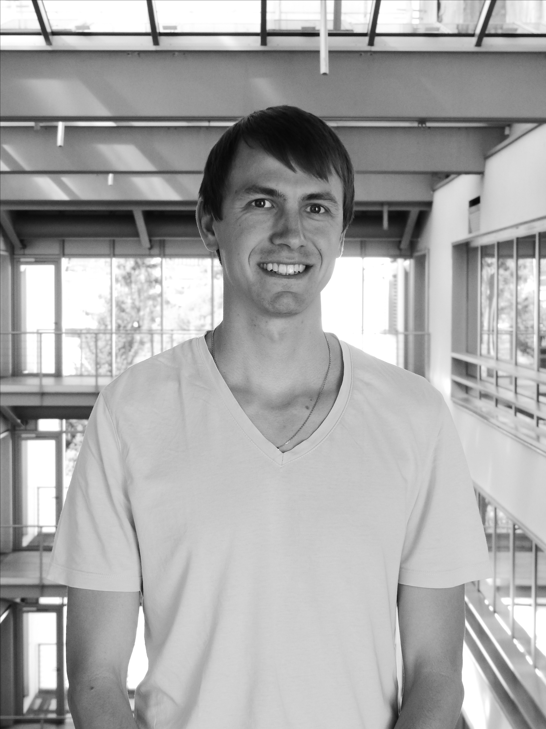

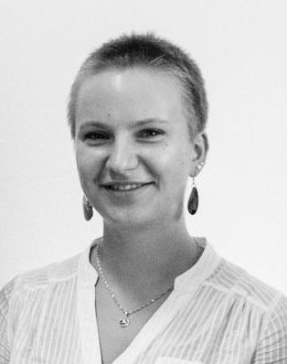

The CLINT Team

Slide 4
What is English as a lingua franca (ELF)
Defining ELF isn’t easy (e.g. Mortensen, 2013)
«English as a lingua franca constitutes an additionally acquired language system which serves as a common means of communication for speakers of different first languages.» (Vienna-Oxford International Corpus of English (VOICE) FAQ; Seidlhofer)
ELF is NOT a variety of English, but the use of English in ELF situations/scenarios
According to corpus studies (Laitinen, 2018) ELF differs from English as a foreign language (EFL) on structural grounds
Notes:
Quote to the difficulty of defining ELF: «Defining ELF as an object of study has been – an continues to be – a troublesome affair» (Mortensen, 2013, p.26)

Slide 5
What is English as a lingua franca (ELF)
ELF in relation to EFL (based on Jenkins et al., 2011, p.284; from slides of Albl-Mikasa, 2018)
EFL | ELF
Standard English as norm and benchmark | English varieties described independently
EFL: deficient (deficit perspective) | ELF: different (liberational perspective)
Deviations from standard indicative of incompetency | Deviations from standard regarded as manifestations of language contact
Aim: correctness | Aim: successful communication
Emphasis on form (-> errors) | Emphasis on function: solidarity, accommodation, communicative-strategic approach
Notes:
- Transfer-Phanomene aus der L1 (oder Lx):
- Akzent, „false friends“, transcoding von Redewendungen
- Verschiedene Manifestationen, L1-abhangig
- Beispiele L1 Deutsch:
- „short and pregnant“ ≠ „kurz und pragnant“ (Albl-Mikasa 2014)
- „the yellow of the egg“ ≠ „das Gelbe vom Ei“ (Albl-Mikasa 2014)
- „We are hardly interested!“ ≠ „Wir sind sehr fest daran interessiert!“ (personl. Komm.)
- „I show you where Beardy gets the cider.“ ≠ „Ich zeig Dir wo der Bartli den Most holt.“
(„Holy Bimbam“ - Wortliche Ubersetzungen schweizerischer Sprichworter)
Ø Shared languages benefit (Albl-Mikasa 2013)

Slide 6
Workload measurement
Gevins (1997):
frontal midline theta: increased magnitude with increased memory load
Parietocentral alpha: decreased magnitude with increased memory load
Often just frontal theta is used as workload measurement
(i.e. Cavanagh & Frank, 2014; Doppelmayr, Finkenzeller & Sauseng, 2008; Ishii et al.1999; Kubota et al. 2001; Luu, Tucker & Makeig, 2004; Rutishauser et al., 2010; Sammer et al. 2007)
Notes:
Gevins: originally intended for monitoring cognitive load during human-computer interaction

Slide 7
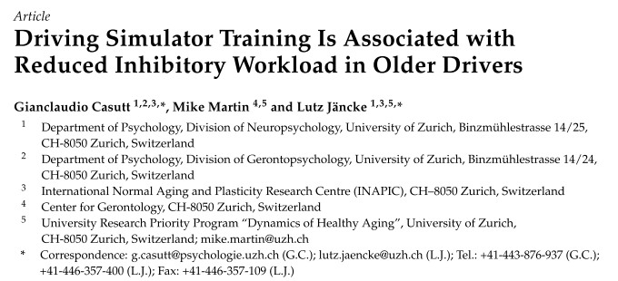
Workload measurement
The theta Fz/alpha Pz-Ratio: (Holm et al., 2009)
Value of index increases with increasing cognitive task demands
Theta Fz/alpha Pz ratio is more sensitive in detecting increased task demands than the absolute power values of frontal theta and parietal alpha (Holm et al., 2009)
In-house application: e.g. Casutt, Martin & Jäncke (2016)

Slide 8
Workload measurement
Psychological or mental stress has strong effects on heart rate and skin conductance (Boucsein, 1992; Reinhardt et al., 2012)
Electrocardiogram data
Shorter inter-beat interval (IBI) during tasks with high cognitive demands (e.g. Fairclough et al., 2005)
Relation of theta band activities and cardiac autonomic functions (e.g. Kubota et al. 2001)
Skin response data
Higher levels of skin conductance with increased workload (e.g. Mühl, Jeunet & Lotte, 2014)
Neurophysiological signals can classify workload with an accuracy of about 75% (Brouwer et al., 2012; Grimes et al., 2008; Mühl, Jeunet & Lotte, 2014).

Slide 9
CLINT participants
Interpreters:
Professionals
MAs
BAs
Translators:
Professionals
MAs
BAs
Multilingual controls:
Professionals (e.g. language teachers, journalists…)
MAs
BAs
Notes:
The goal is to get 30 participants for each subgroup -> resulting in 270 participants in total

Slide 10
Interpreters & Translators: Two PhD projects
Shared resources but different experimental set-ups
Project «Interpretation»:
PhD project of Michi
The focus for the rest of the presentation
Project «Translation»:
PhD project of Matthias
More information coming soon ☺

Slide 11
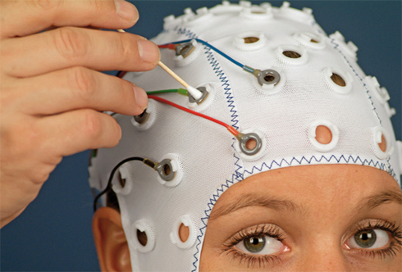

Experimental set-up for the interpreters – overview
Listening task
Shadowing task*
Interpretation task*
Listening task
Shadowing task*
Interpretation task*
Lexical decision task
*order randomized; (ELF = English as Lingua Franca; SE = Standard Engish)
Text 1* – ELF*
EEG system:
Text 2* – SE*
Notes:
Each participant will work with each text either in the ELF or SE version (not both) -> counterbalanced across subjects

Slide 12



Experimental set-up: Listening task
+
Were the participants requested to wear the same jeans for six weeks?
SE / ELF
No
Yes
Listening to the first part of the respective text for 6 minutes
After listening to the text, four forced choice questions have to be answered
→ Input control

Slide 13


Experimental set-up: Shadowing task
X O X O X …
t
Overt or covert shadowing (repetition) of the heard input depending on the sign presented on the screen as instantaneous as possible
The stimulus-text will continue from where it stopped at the end of the last task (to make sure, the participants have some context)
At the very beginning of the experiment a short testing trial will be presented
Workload estimation question at the end of the task

Slide 14
Experimental set-up: Interpretation task
X O X O X …
t
Overt or covert interpretation of the heard input depending on the sign presented on the screen as instantaneous as possible
The stimulus-text will continue from where it stopped at the end of the last task (to make sure, the participants have some context)
At the very beginning of the experiment a short testing trial will be presented
Workload estimation question at the end of the task

Slide 15
Experimental set-up: Lexical decision task
+
Pseudoword
Word
P – G – G – E – E – G – E – P – P – … (P: Pseudoword (G & E); G: German word; E: English word
Forced choice lexical decision task with instructed as fast as possible left-clicks for pseudowords and right-clicks for words (either G or E)
Focus on language switch trials (G – E or G – E)
The sequence will contain:
160 German words, 160 English words, 160 Pseudowords (80G & 80 E)
Each 70 G – E and E – G switch trials
Each 38 G – G and E – E non-switch trials

Slide 16
Planned data analysis
Workload:
Frequency band analysis: focus on theta & alpha band
Comparison of the Theta Fz/alpha Pz ratio between:
ELF and SE texts (within groups)
Between group effects (e.g. interpreters vs. multilinguals or interpretation beginners vs. Experts)
Comparison of IBI/HRV and/or GSR values between:
ELF and SE texts (within groups)
Between group effects
Combination of both the above mentioned
→ relationship between EEG workload measurements and ECG / skin conductance measurements
Notes:
Probably the covert interpretation data will be used for these analyses

Slide 17
Planned data analysis
ERP analysis (i.e. N400) of the lexical decision data:
G – E vs. E – G trials (professional interpreters vs. Bas or multilinguals)
Word vs. pseudoword trials
Switch vs. non-switch trials

Slide 18
Current status
Intended start of data acquisition: may 2019
Open Issues: pilot tests
coordination of VP appointments with Winterthur

